Slide 1

Project Management Consultant Coordination
ORB University

Slide 2
What are consultants and why do we have to coordinate them?
Site Consultants
Civil
Landscape architects
Geotech
Dry utility services
Building/ Systems Engineers
Mechanical
Plumbing
Electrical
Structural
Fire protection
Specialties
Interior Designers
Building Envelope
Accessibility
Acoustic
Pre-cast structures
Signage
Pool and spa
Often contracted directly with Owner/ developer
Typically contracted within architect scope
Varies on each project

Slide 3
What are consultants and why do we have to coordinate them?
Site Consultants
Work early in the process
Help get through entitlements, continue working through CDs
Often have their own permitting process
Building/ Systems Engineers
Brought on during Design Development
Engineered design required for permitting
Specialties
Typically, not required for permitting unless City stipulates it
Is often included as “Deferred Submittal” and/ or “Separate Permit” work

Slide 4
What are consultants and why do we have to coordinate them?
Site Consultants
Ensure code compliance of the site and property features
Ensure the building is not interfering with easements, utilities, required drainage
Ensure the site meets City or AHJ standards for planting and hardscape requirements
Building/ Systems Engineers
We (architect) are contracted to “get” a permit for construction
We are owners of the contract drawings during the permitting process, this includes engineer’s drawings if they are contracted under us.
Specialties
Ensure code compliance of spaces or building elements as needed
Coordinate for structural or MPE needs
Review changes to ensure they do not negatively affect the building or it’s function

Slide 5
How do we coordinate with our consultants?
COMMUNICATION

Slide 6
How do we coordinate with our consultants?
Tools for Communication
Design meetings
Emails
Phone calls
Plan mark ups
AutoCAD or Revit backgrounds
As the architect, we are the head of the design team
Communication with the client and/ or contractor and the design team should always include the architect
This includes conversations where the consultant is not under our contract
Example – civil engineer is asked by contractor to provide more on-site retention. Civil engineer says yes. Architect is not notified and leads to issues due to approved planning requirements from AHJ
Set expectations early
Confirm who is point of contact
Set expectations for how often backgrounds will be sent out or received
Include deadlines, schedules or formatting information early on

Slide 7
Design Meetings
Typically occur more often at the beginning of a project (Design Development) and less frequently during documentation (Construction Documents)
Limit attendees to two or three (max) ORB team members to avoid high cost and billable hours
If there are several areas of the building to cover, consider staggering the consultants to limit how much time they need to commit to.
Set agendas for your meetings, take notes and circulate notes afterwards
Also consider if the coordination needs to include the Owner and/ or Contractor or if it should be an internal meeting
Remember to also ask, is this something that could be an email or a phone call?

Slide 8
Emails and phone calls
Using email is an effective way of communicating, as long as consultants are responsive.
A good thing to remember about emails, especially when you’re frustrated: “Is this something I want read aloud in a court of law?”
Be mindful of what you put out there as jokes or sarcasm can be misconstrued easily.
Sometimes, you will run into a consultant who does not respond to emails.
When you have sent an email (or two) and still haven’t gotten an answer, pick up the phone and call. If they are unavailable, leave a message.
If you still don’t hear back from them, reach out to the main office line and request to speak to an office manager or supervisor to see if there is an illness, family emergency or vacation that is causing the lack of communication.
If one of those items is the case, ask if there is someone else to discuss the project and get what you need.
If it is not, and your consultant is simply not responding, escalate the issue to your Project Manager so they can take steps to remedy the situation.

Slide 9
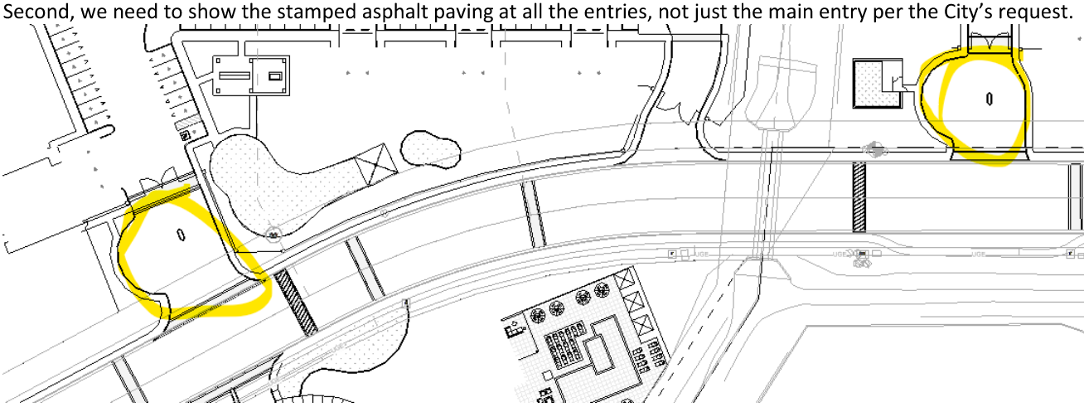
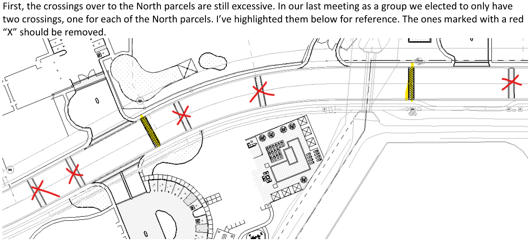
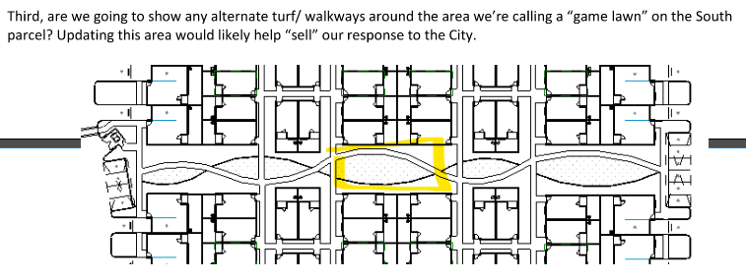
Plan mark ups
This is maybe the most time-consuming task, but often the one that can solve many problems before they become problems.
It begins with reviewing consultant’s drawings and backgrounds.
Anytime a consultant sends over a drawing, we should open the document and make sure all comments, changes or updates have been made. Don’t assume it’s correct. This makes the consultant look bad to the client but also makes us look bad as it’s our job to review if we don’t catch errors.
Example – we provided an updated site background to our landscape architect. They sent us their “updated” AutoCAD file, below are just a few notes we had to send back:

Slide 10
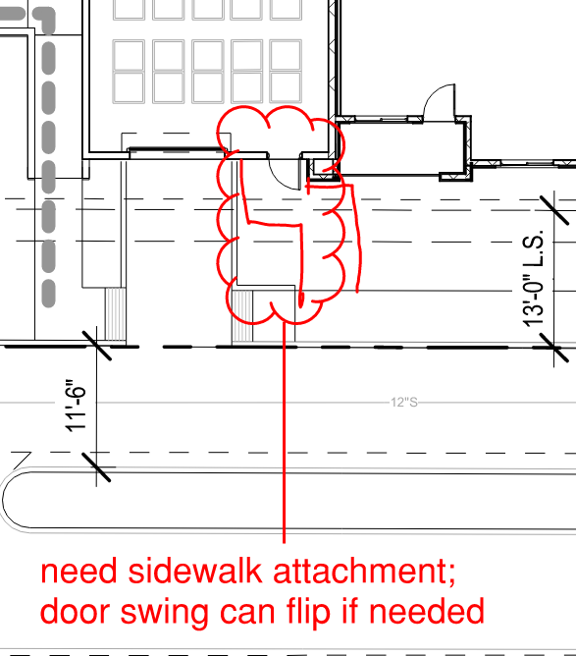
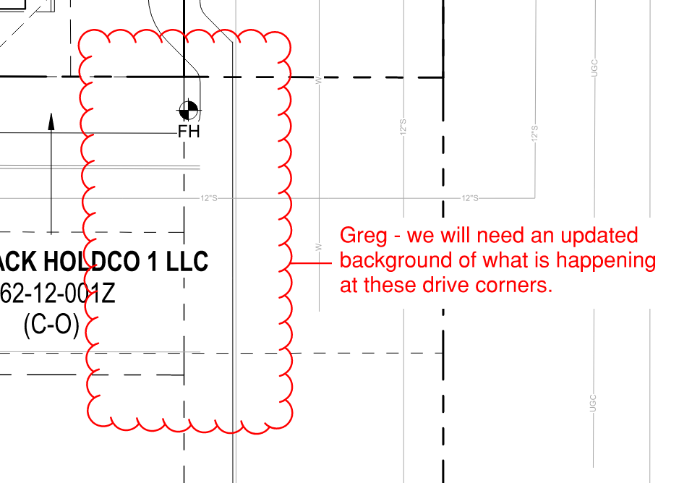
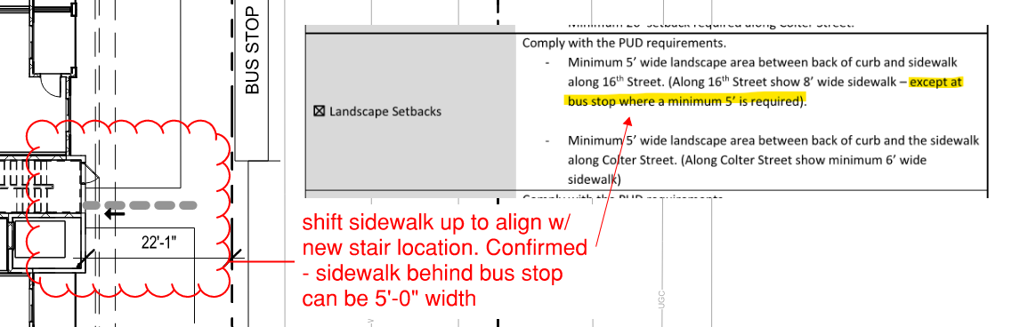
Plan mark ups
Anytime there are changes to the building, you can use plan markups to point out specifics. While the backgrounds include our changes, consultants don’t always know what to look for.
Remember that the person you talk to daily may not be the person doing the work
These can be quick notes or redlines, doesn’t have to be fancy
These can also be a way of answering questions or follow up from a design meeting or phone call you’ve had with your consultant

Slide 11
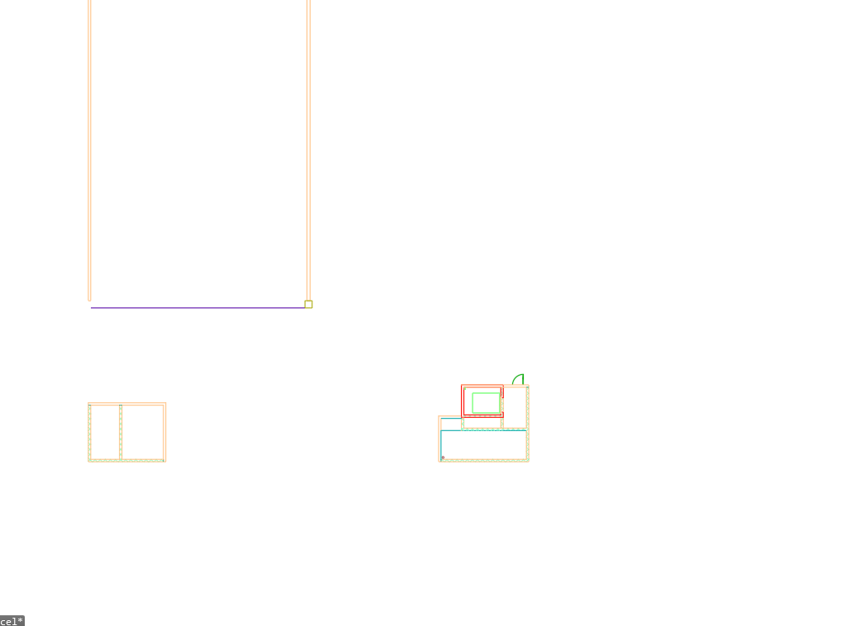
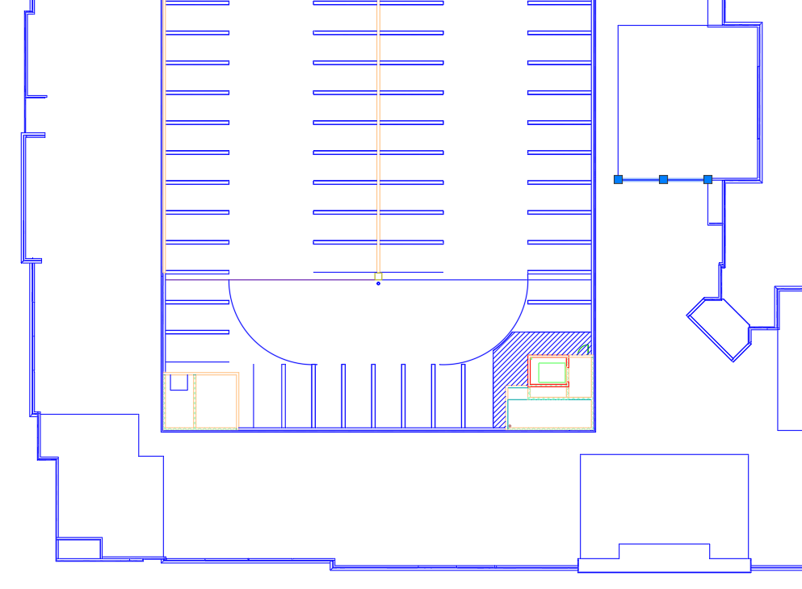
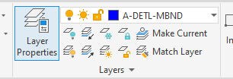
AutoCAD and Revit backgrounds
These are probably the most crucial form of coordination we do with our consultants
Include a PDF that corresponds to your plan exports, even if it’s still drafts. The consultant can answer a lot of questions on their own this way.
Don’t assume the exports are right. Always open them and double check before sending out
Check for room names on unit plans
Check for unit names/ numbers on overall building plans
Confirm design options are shown
Make sure view range is set correctly (especially on site and roof plan exports) so all the linework is not on one layer

Slide 12
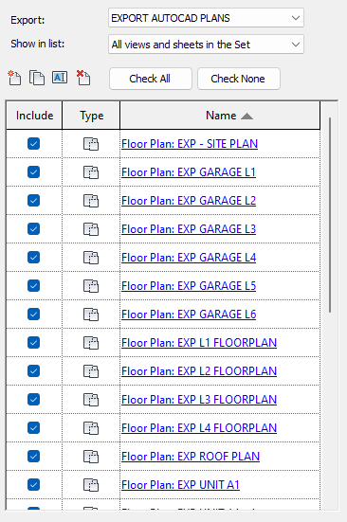
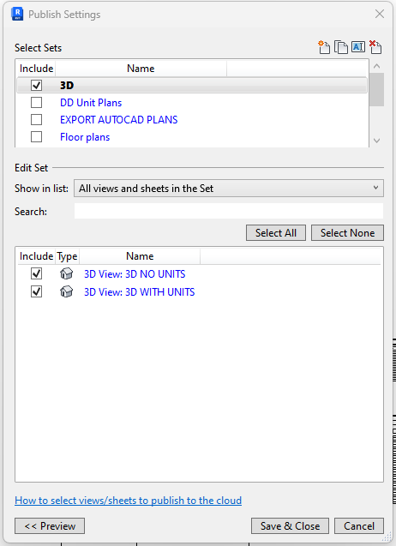
AutoCAD and Revit backgrounds
With Revit models – confirm worksets and building elements are set up correctly
Confirm any additional links that need to be included in publish such as unit models or survey files so consultants have all the pieces while working
Still include a PDF set and mark-ups
Set up Export sets and Publish sets early on in the project. Keep these sets updated as plans and sheets are added. This will help relay information quickly and consistently.
If don’t know how to set up these sets, ask the PM or BIM managers for help
Establish naming conventions early on and stick with it. Changing any part of a title can affect pathing for consultants.
Get updated backgrounds to consultants with enough time for them to make their changes. Focus on model changes before things like dimensions, keynotes or tags as those items can be handled while the consultants are making their changes.

Slide 13
Remember – it all comes back to:
COMMUNICATION

